Slide 1
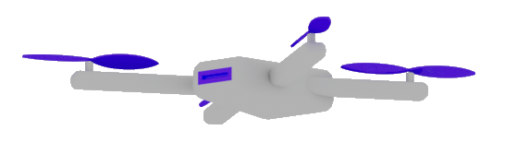
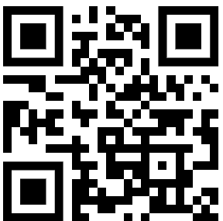
Building Smart Agents and Custom Copilots with GenAI and Semantic Kernel
Dr. Damir Dobric
Lead Software Architect daenet GmbH / ACP Digital
Microsoft Regional Director,
Most Valuable Professional: Azure + IoT

Slide 2
What is an Agent?
An agent is an AI application that uses LLM and can
Answer questions
Invoke functions
Automate processes
. . .

Slide 3
What is a Copilot?
A Copilot is an AI application that consists of one or more agents,
which orchestrate tasks.

Slide 4

Software V2
The new Generation of Software
“After tomorrow”
“Tomorrow”
Quantum Computing
Software
Today
AI & Large Language Model Integration
Syntax Driven Languages

Slide 5
SEMANTIC KERNEL

Slide 6
Semantic Kernel is an open-source SDK that lets you easily combine Generative AI Models syntactic programming languages like C#, Python an JAVA.
Currently supported languages: C#, Python
Currently supported AI Services: OpenAI, Azure OpenAI, and Hugging Face
Introduction | 🦜️🔗 Langchain

Slide 7
Why to use SK?
SK is a framework to build agents
You can easily use LLM models for chat, create images and video so on.
Making automated Agents that automate business processes is hard?
You need a framework for such complex engineering tasks.

Slide 8
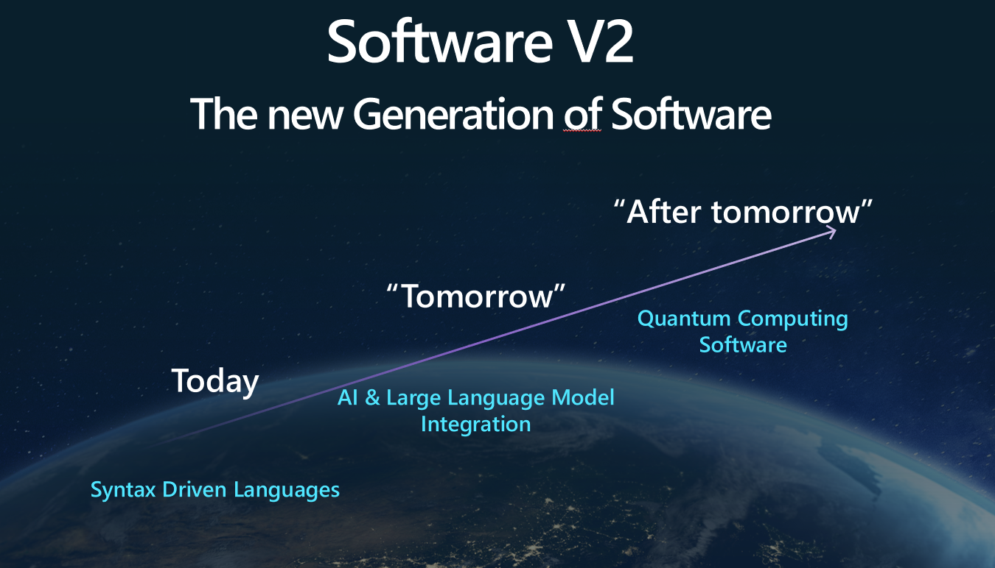
The Knowledge is inside Plugins
Native Functions (C#, Python, JAVA, ??)
Prompts (Semantic Functions)

Slide 9
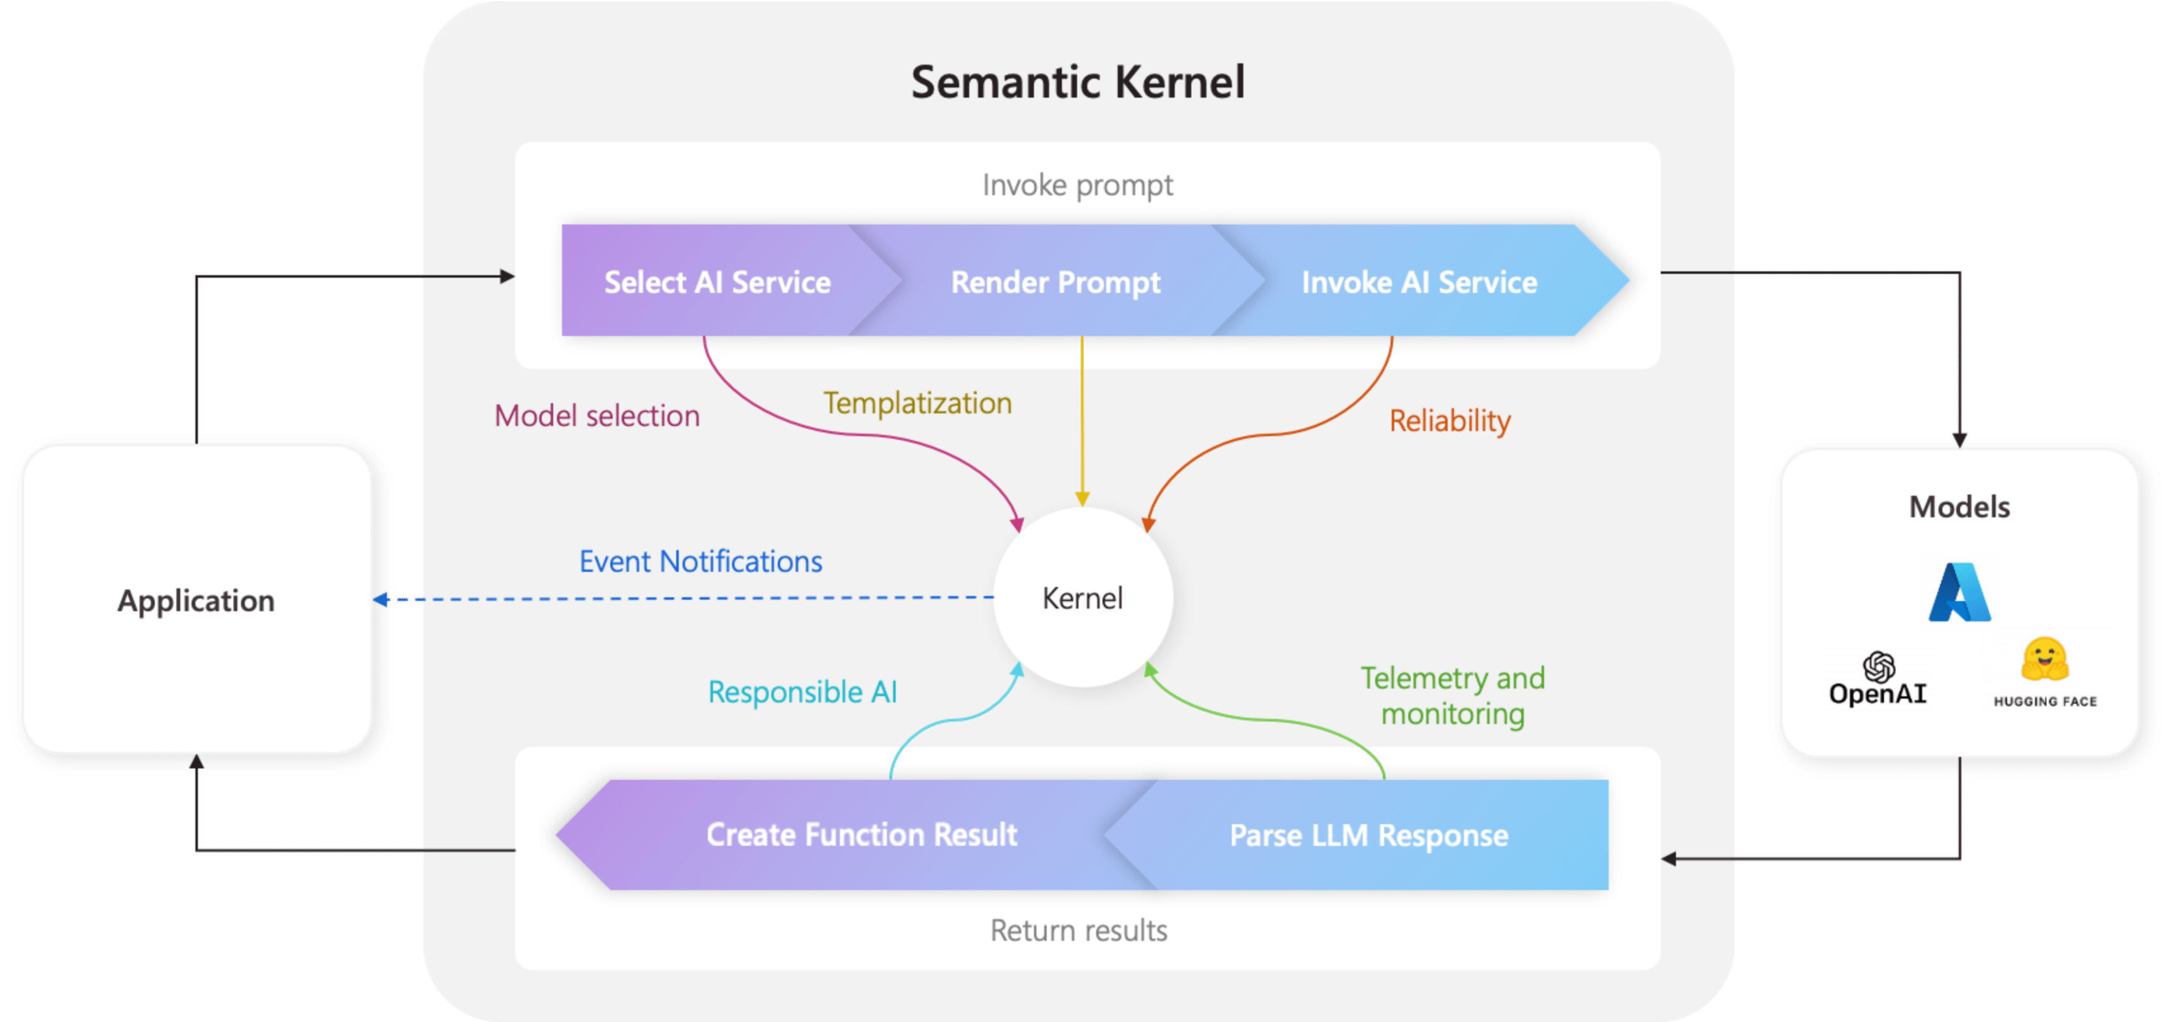
Architecture of the “Smart” application

Slide 10
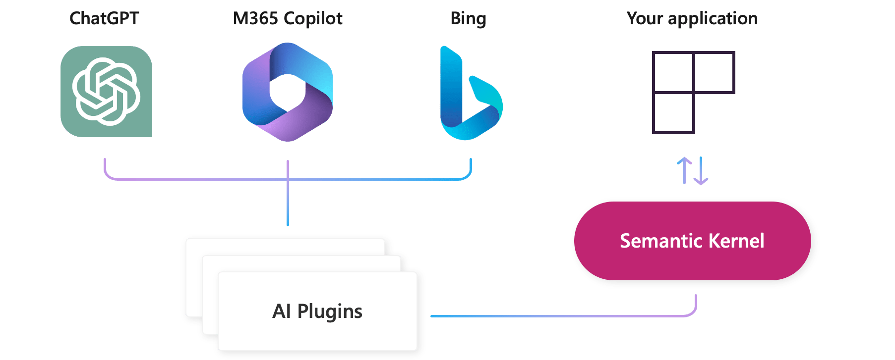
AI Plugins
Your SK application
a plugin is a group of functions
that can be exposed to AI applications
OpenAI plugin specification

Slide 11
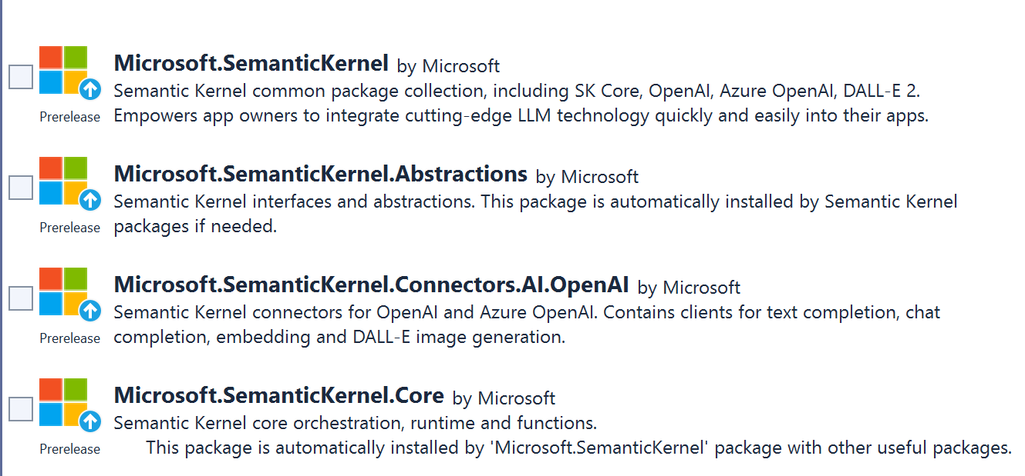
SEMANTIC KERNEL OVERVIEW

Slide 12
NATIVE FUNCTIONS
[KernelFunction, Description("Gets the UTC current time.")]
public DateTime UtcNow()
{
return DateTime.UtcNow.ToString();
}
A native function is a function
defined by the code

Slide 13
PROMPTS (SEMANTIC FUNCTIONS)
Inline Functions
string prompt = @"Bot: How can I help you?
User: {{$input}}
---------------------------------------------
The intent of the user in 5 words or less: ";
A semantic function is a function
defined by the LLM prompt
Plugins
│
│─── Plugin1
│
│─── Function11
│─── Function12
└─── Plugin2
│
│─── Function21
│─── Function22
Add Ins
In-file Functions

Slide 14
PlugIn DEMOs
Controlling the lighting system
PlugIn Test Console

Slide 15

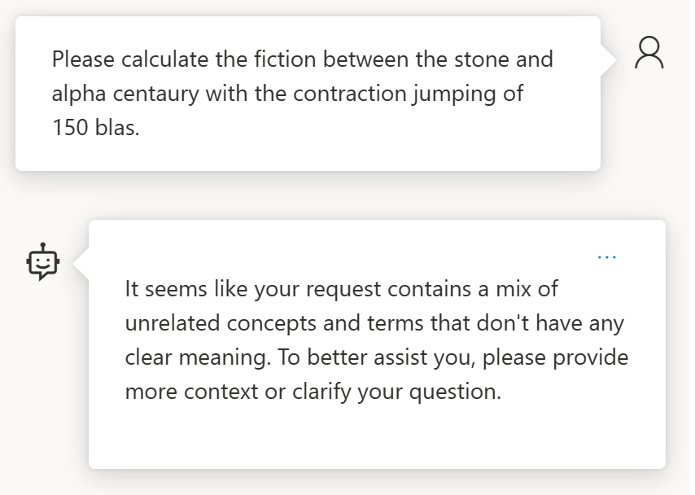
How about something not solvable?

Slide 16


References
Azure/aistudio-copilot-sample at oct-refresh (github.com)
Microsoft Copilot Studio
https://platform.openai.com/docs/models https://oai.azure.com/portal/****/models
Azure AI Studio
Semantic Kernel
AI-Generated 3D Worlds
Imagine AI Art Generator
Midjourney
Azure AI SDK - Azure AI Studio
BOOK OF NEWS - Microsoft Ignite

Slide 17
Building Smart Agents and Custom Copilots with GenAI and Semantic Kernel
Dr. Damir Dobric
Lead Software Architect daenet GmbH / ACP Digital
Microsoft Regional Director,
Most Valuable Professional: Azure + IoT

Slide 18
Microsoft confidential
https://github.com/ddobric/semantic-kernel-training

Slide 19
Nested Semantic Functions Semantic function invokes a semantic function
{{SamplePlugin.Translator $input}}
-----------------------------------------------
Summarize and compress abstract to 50 words, using a user friendly language.
[Input]
{{$input}}

